Slide 1
Joint Research Centre
The European Commission’s in-house science service

Slide 2
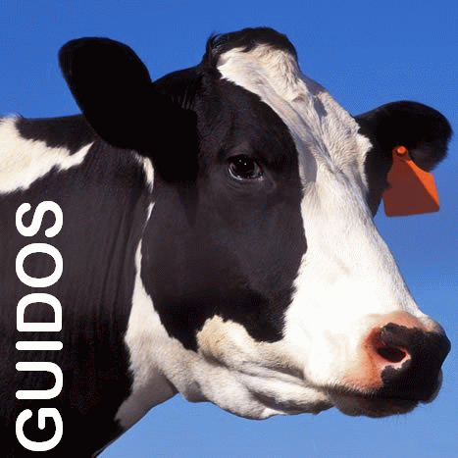
GuidosToolbox Workshop
The workshop will address the following topics:
1) Introduction and motivation for new ways of pattern analysis
2) MSPA: Morphological Spatial Pattern Analysis 3) GuidosToolbox: program features and processing options 4) Hands-On examples using a training data set:
a) data preparation b) MSPA, connectivity, fragmentation, contortion, mosaic, … c) post-processing: exporting to GeoTiff, Google Earth overlays

Slide 3
GuidosToolbox Workshop
4) Examples
Training Data Set
4 A) Data Preparation & Processing
4 B) Image Object Analysis
4 C) Data Post-Processing

Slide 4
4 A) Data Preparation & Processing
A1: Image properties and MSPA parameters (see MSPA-Guide)
A2: Setup MSPA-compliant image (p. 7)
A3: Cut image and build binary mask
A4: Reproject, MSPA, save as and display kml (GE)
A5: Import/prepare proprietary/non-tiff non-tiff images
A6: Batch-process (MSPA (-tiling), Moving Window, Recode, Fragmentation, etc.)

Slide 5
4 A) Data Preparation & Processing
A1. Image properties and MSPA parameters (see MSPA-Guide)
Read Image → GeoTiff: input.tif
Browse through the image with the mouse pointer and check the information panel below the display
Play with: Autostretch, Normalized , Colortable, Zoom
Restore original image: General Tools → Original Image
and test: Image Info e) process MSPA with different settings for FGconnectivity, EdgeWidth, Transition, Intext; MSPA statistics
f) Activate core grouping and change thresholds

Slide 6
4 A) Data Preparation & Processing
A2. Setup MSPA-compliant image, i.e., for forest (p. 7)
Read Image → GeoTiff: clc.tif, Autostretch
get image information, try doing MSPA
Recode: 0(Missing) ←1-11, 1(BG) ←12-21/26-41, 2(FG)←23-25 (restore the file: GTrecode_CLC2MSPA.sav)
Save as GeoTiff: clc_recode.tif
Read clc_recode.tif ; Pattern Analysis → MSPA ; save output
General Tools → GIS SW → GTB Terminal: gdalinfo -noct -mm -stats clc_recode_8_1_1_1.tif and compare with: Image Info

Slide 7
4 A) Data Preparation & Processing
A3. Cut image and build binary mask
Read Image → GeoTiff: il3.tif, Image Info
Cut central data area: start GTB Terminal and enter:
gdal_translate -srcwin 3000 4000 1000 1000 -co COMPRESS=LZW il3.tif il3sub.tif ( gdal_translate -srcwin xoff yoff xsize ysize -co COMPRESS=LZW input.tif output.tif )
Read image il3sub.tif, Image Info
Binary image: use Preprocessing → Threshold at 106 byte
Swap FG/BG (Preprocessing → Invert), image info
Safe as GeoTiff: il3sub_106.tif

Slide 8
4 A) Data Preparation & Processing
A4. Reproject to WGS-84, MSPA, save as GoogleEarth overlay
a) Read Image → GeoTiff: il3sub_106.tif
b1) GTB Terminal: find out EPSG-code: gdalinfo -noct il3sub_106.tif
Reproject to WGS84 (EPSG 4326, EPSG, epsg-codes, GE): gdalwarp -s_srs EPSG:3035 -t_srs EPSG:4326 il3sub_106.tif il3sub_106_EPSG4326.tif b2) use Preprocessing → Reproject for GoogleEarth
c) Read il3sub_106_EPSG4326.tif into GTB & process MSPA
d) Save the result as kml: Save Image → KML

Slide 9
4 A) Data Preparation & Processing
A4. Reproject to WGS-84, MSPA, save as GoogleEarth overlay
Open directory C:\GuidosToolbox\data
Do not double-click but right-click and fully extract: il3sub_106_EPSG4326_8_1_1_1_kml.zip
Open new directory: il3sub_106_EPSG4326_8_1_1_1_kml
Double-click the file: MSPA_GuidosToolbox.kml (or open this file in GoogleEarth)

Slide 10
4 A) Data Preparation & Processing
A5. Import/prepare proprietary/non-tiff images
Read/import images from data-subdirectories: bil, erdas, arc
Read/import your own images …

Slide 11
4 A) Data Preparation & Processing
A6. Batch-process (MSPA, Mov.Window, Fragmentation, etc.)
Start GuidosToolbox. File → Batch Process → MSPA
Browse to directory batch/<subdir>/ and select all images
Process with default MSPA settings (+ statistics), kernel, fragmentation type, recode setting, …
(Optional): Process large image using MSPA-tiling
Read image largeWin.tif
Obtain image information
Process with default MSPA settings

Slide 12
4 B) Image Object Analysis
B1: Label Objects (p. 24)
B2: Euclidean Distance (p. 24)
B3: Influence Zones (p. 25)
B4: Proximity (p. 26)
B5: Fragmentation (p. 19)
B6: Cost Analysis (p. 27)
B7: Landscape Mosaic (p. 15)
B8: Contortion (p. 29)
B9: Change (p. 30)
B10: Network (p. 17)

Slide 13
4 B) Image Object Analysis
B1. Label Objects (p. 24)
Important: meaningful distance measures require equal area projection!
Read Image → GeoTiff: input.tif,
Image Analysis → Distance → Label Objects
Change thresholds for FGConnectivity and EdgeWidth
Read pixel values & features in the information/title bar
Play with the Zoom mode and the zoom factors

Slide 14
4 B) Image Object Analysis
B2. Euclidean Distance (p. 24)
Important: meaningful distance measures require equal area projection!
Read Image → GeoTiff: input.tif
Image Analysis → Distance → Euclidean Distance
Activate distance ranges and change thresholds
Check GuidosToolbox Manual for distance values: adb, adf.
(Optional: Save as KML and display it in Google Earth)

Slide 15
4 B) Image Object Analysis
B3. Influence Zones (p. 25)
Important: meaningful distance measures require equal area projection!
Read Image → GeoTiff: input.tif
Image Analysis → Distance → Segm.→ Influence Zones
Change thresholds for FGconnectivity, EdgeWidth
Play with buffer zones inside/outside
Read pixel values & features in the information/title bar
Play with the Zoom mode and the zoom factors
(Optional: Save as KML and display it in Google Earth)

Slide 16
4 B) Image Object Analysis
B3. Proximity (p. 26)
Important: meaningful distance measures require equal area projection!
Read Image → GeoTiff: input.tif
Image Analysis → Distance → Segm.→ Proximity
Change thresholds for FGconnectivity, EdgeWidth
Play with CoreZone buffer and Prox_max
Read pixel values & features in the information/title bar
Play with the Zoom mode and check watershed pixels
(Optional: Save as KML and display it in Google Earth)

Slide 17
4 B) Image Object Analysis
B5. Fragmentation (p. 19)
Read Image → Generic: inputzz.tif. Difference to input.tif?
Image Analysis → Fragmentation → Map → Entropy
Image Analysis → Fragmentation → Map → Contagion
Image Analysis → Fragmentation → Index → Hypsometry
Difference of Entropy, Contagion, Hypsometry?
Activate Fragmentation range and change the thresholds

Slide 18
4 B) Image Object Analysis
B6: Cost Analysis (p. 27)
Read Image → Generic: mask.tif, Autostretch, Image Info
IAnalysis → Cost → Cost Map A: mask_marker.tif
General Tools → Original Image
IAnalysis → Cost → Cost Map AB: mask_marker.tif
Play with Zoom mode and cost ranges (i.e. 5041/6500)
General Tools → Original Image
IAnalysis → Cost → Cost Map AB: mask_marker_river.tif
IAnalysis → Cost → Cost Map A: mask_marker_river.tif

Slide 19
4 B) Image Object Analysis
B6: Cost Analysis (p. 27)
Read Image → GeoTiff: clc.tif, Autostretch, Image Info
General Tools → Preprocessing → Reproject for GE
Read Image → GeoTiff: clc_EPSG4326.tif, Autostretch
General Tools → Preprocessing → Add 1 Byte
IAnalysis → Cost → Cost Map AB: clc_EPSG4326_marker.tif
Play with Zoom mode and cost ranges (i.e., 18000|22000)

Slide 20
4 B) Image Object Analysis
B6: Cost Analysis (p. 27)
Save Image → GeoTiff (if time also as kml)
View kml file in Google Earth and other files in a GIS:
General Tools → GIS SW → OpenEV/QGIS (ENVI, ARC, etc)
Load the following 4 files:
clc_EPSG4326 (_marker/_costmapAB-range/data_geo).tif
Switch between layers: compare cost ranges, data, LCP

Slide 21
4 B) Image Object Analysis
B6: Cost Analysis: setup marker image (p. 7, 27)
Read Image → GeoTiff: clc.tif, Autostretch, Image Info
General Tools → Preprocessing → Cost Marker Image
Move mouse in viewport and check messages below
(Zoom in), click on object and press Enter key or space bar
Follow the instructions to define the marker image
Load new cost marker image into GTB to verify your setup
(i.e.: A: [437, 1300], B: [733, 96], Missing: [537, 820] ) Read Image → GeoTiff: clc_marker.tif, Autostretch, Image Info
Note: if needed use Recode to reassign resistance classes and merge several classes into one class for Missing Data

Slide 22
4 B) Image Object Analysis
B7. Landscape Mosaic (p. 15)
Read Image → GeoTiff: clc.tif
Preprocessing → Recode: GTrecode_CLC.sav input (AND): Agriculture (1b), Natural (2b), Developed (3b)
(optional: other (0b)); verify changes with: Image Info
Image Analysis → Pattern → Moving Window → LM
Test different window sizes (reset via Undo option)
Move mouse pointer in viewport and check the Manual on page 15 for class values.

Slide 23
4 B) Image Object Analysis
B8. Contortion (p. 29)
Read Image → GeoTiff: input_small.tif
Image Analysis → Contortion Contortion/Area or Contortion/Perimeter or Contortion
Activate and play with Range division
Omitted objects? Reprocess smaller object sizes changing MSPA parameter 2 EdgeWidth to 6 and 1
Zoom in and check contortion value of small objects.

Slide 24
4 B) Image Object Analysis
B9. Change Detection (p. 30)
Image Analysis → Change →
a) Simple Change: Read images fmap1990/2000.tif
Output: difference of any combination of [0, 1, 2] byte: [-2, 2]
b) Morph. Change: Read images fmap1990/2000.tif
Output: 11b – BG/BG, 12b – BG/FG (gain), 21b – FG/BG (loss),
22b – FG/FG, 176b – neglected, spurious changes,
c) Compare PNG: Read images fmap1990/2000.png use bottom slider to visualize either image.

Slide 25
4 B) Image Object Analysis
B10: Network/Connectivity (p. 17)
Read Image → GeoTiff: input.tif and process for MSPA
Image Analysis → Network - NW components, Node/Link Importance
- Undo, NW Component Connectors
Play with the Zoom mode and the zoom factors
Save the result as GeoTiff
Compare statistic file and display data in viewport

Slide 26
4 C) Data Post-Processing
C1: Export results in different formats
C2: View/browse results in different GIS software: OpenEV, QGIS, ArcInfo, ENVI, …

Slide 27
4 C) Data Post-Processing
C1: Export results in different formats
Export options for your processed images: File → Save Image
→ GeoTiff versatile, can be read by any Software! → Generic no GeoHeader → Display Snapshot quicklook for presentations → KML Google Earth/Maps, OpenLayers
→ output for graph theory analysis in Conefor

Slide 28
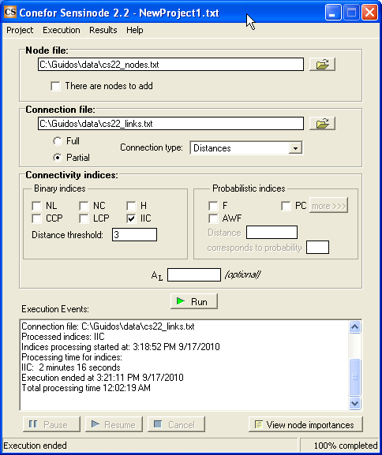
4 C) Data Post-Processing
C1: Export results in different formats
Conefor needs 2 files: Nodes & Dist./Links
a) File → Batch Process → Conefor Inputs (p. 5) Data: any, having value of zero for BG: Objects (labels/size) & Distances between objects
Connectivity is defined via pairwise distance
b) IA → Network → MSPA Conefor Inputs (p. 18) Data: MSPA image using only Core & Bridge Cores (labels/size) & Connectivity Table Connectivity is defined via MSPA-bridges

Slide 29
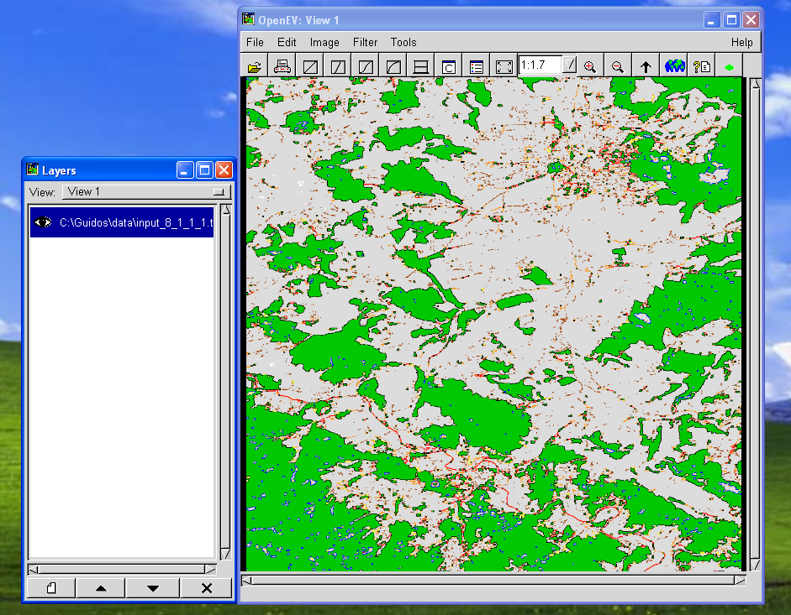
4 C) Data Post-Processing
C2: View results in OpenEV

Slide 30
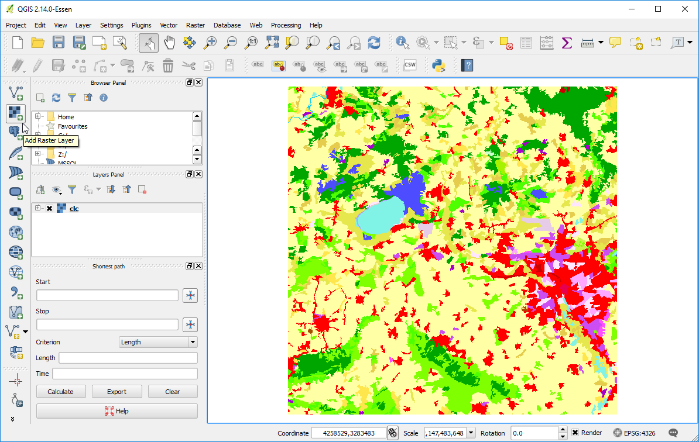
4 C) Data Post-Processing
C2: View/browse results in QGIS

Slide 31
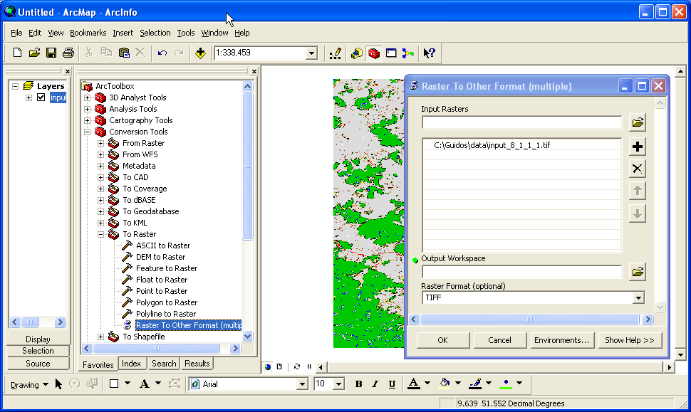
4 C) Data Post-Processing
C2: View/browse (GeoTiff) results in ArcInfo/ArcGIS
Conversion to/from grid in arc terminal: imagegrid/gridimage
Import: File → Add Data Export: see to the right

Slide 32
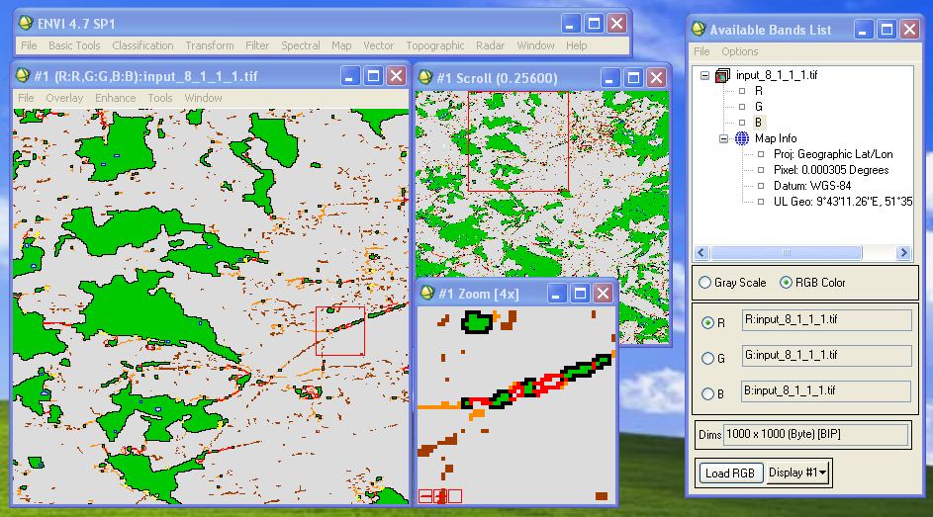
4 C) Data Post-Processing
C2: View/browse (GeoTiff) results in ENVI

Slide 33
4 C) Additional Information
Help → GuidosToolbox Manual / MSPA Guide / …
Help → News / Check for Updates / GTB Workshop…
Incremental revision- and program releases
MSPA cmdline: C:\GuidosToolbox\MSPAstandalone
GTB: start any application from the self-contained directory
MSPA papers, GE-overlays: C:\GuidosToolbox\publications
CCRS Remote Sensing Tutorial GIS Introduction

Slide 34
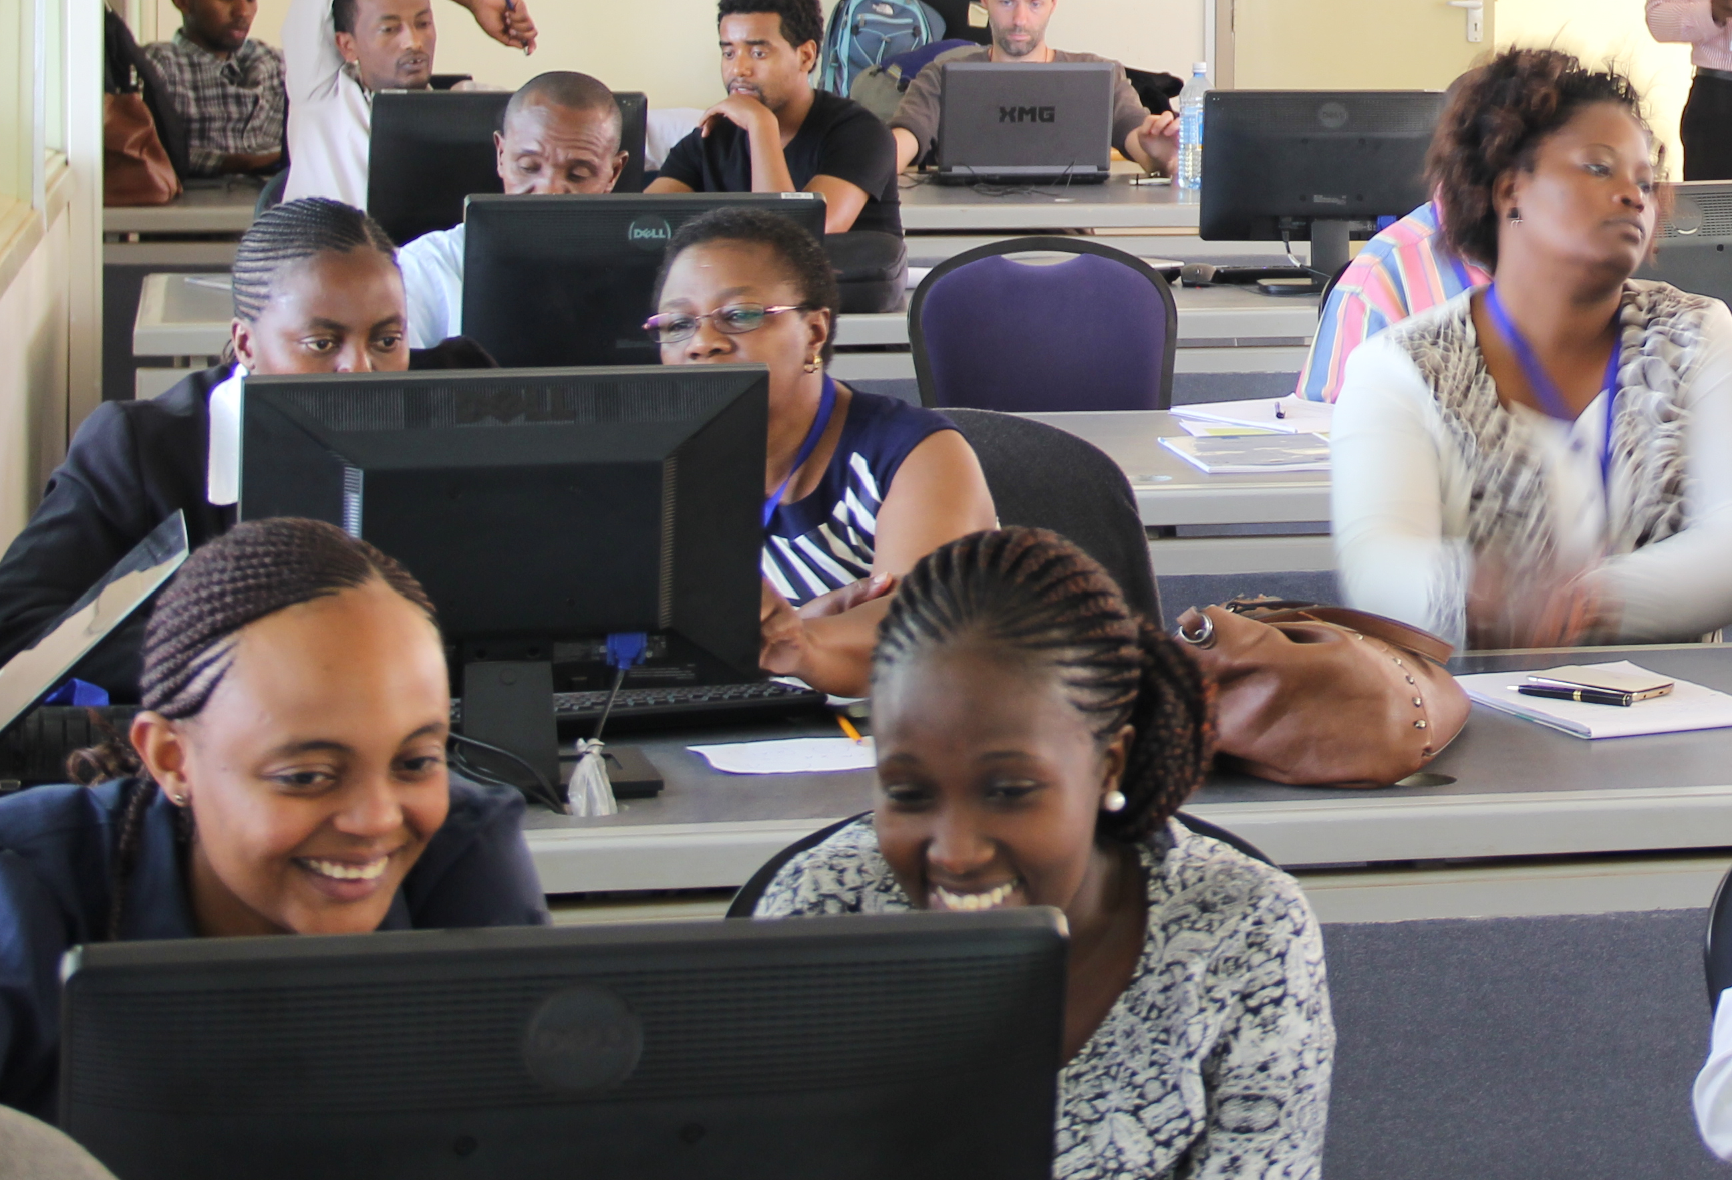
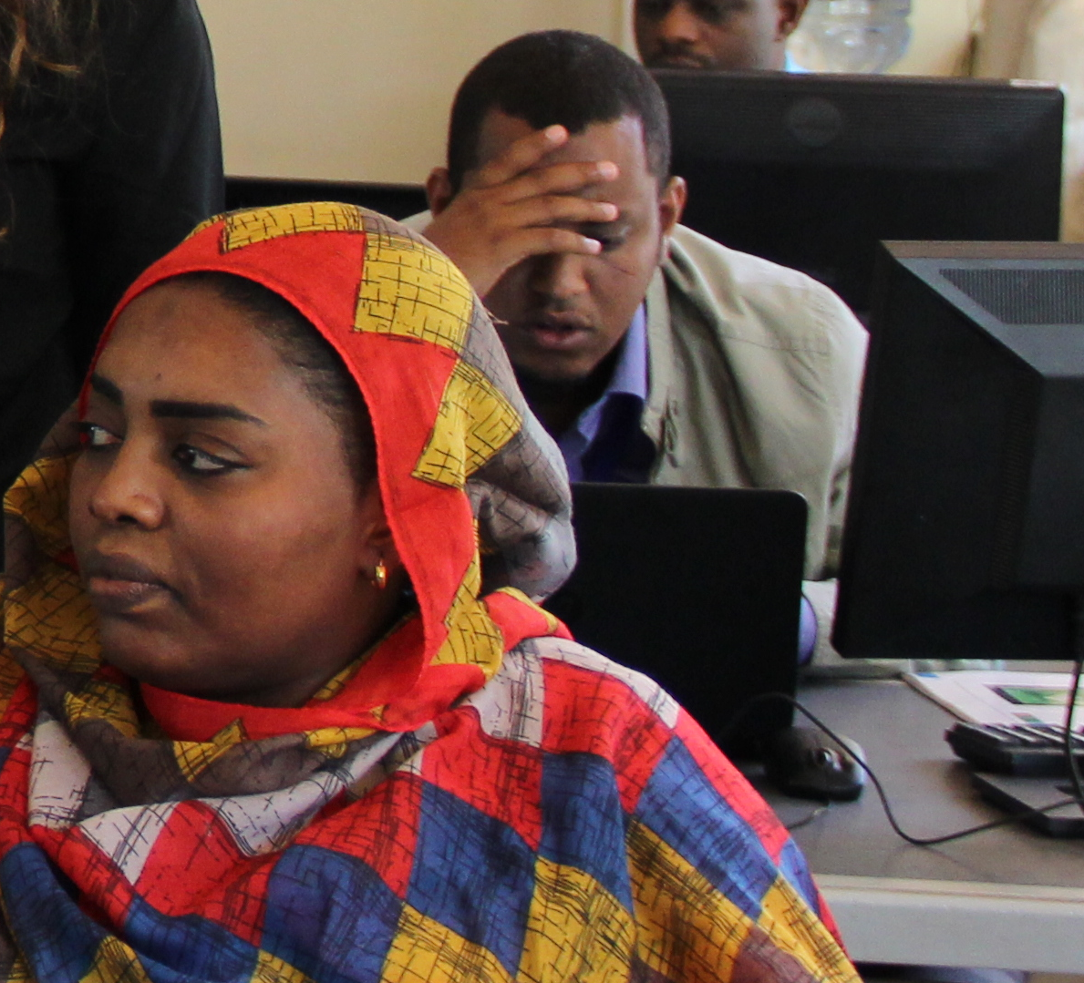
Workshop experience
Boredom
Desperation
Excitement
Indifference
Please provide feedback & email your comments to me: C:\GuidosToolbox\data\GWS_feedback_form.xls

